Slide 1
The Power of Physics Estimation… …in sorting out future options
Tom Murphy
UCSD Physics

Slide 2
Inspired By…
Famous physicists like Fermi and Feynman frequently formulated fantastic feats of estimation
optional: “estimation” → “finagling figures”
Best course I ever took: Order of Magnitude Physics at Caltech
team-taught by Peter Goldreich and Sterl Phinney
Estimation and Scaling in Physics (UCSD Phys 239)
team-taught by Fuller, Diamond, Murphy spring 2010, 2012, 2014

Slide 3
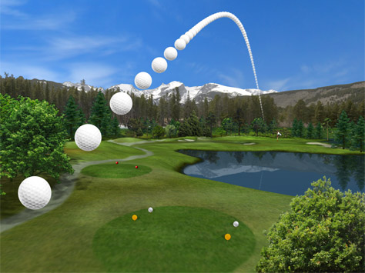
Our Trajectory Today
Fermi Problems
Climate Change
Limits to Growth
Fossil Fuel Replacements?
Energy Storage
Fuel Economy of Cars and EV Math

Slide 4
Color Coding to Clarify
Black: generic/default
Orange-brown italics: emphasis
Red: assumptions
Blue: constants/knowledge
Purple: results
A note on numbers:
math is a lot easier if you don’t take numbers so seriously
π = 3 = sqrt(10) = 10/3
2 ≠ 3, but 8 ≈ 9
c, e, h, k_{B}, m_{p}, m_{e}, σ, G, N_{A}, μ₀, ε₀, R_{E}, M_{E}, r_{AU}, etc. by memory

Slide 5
Fermi Problems
How many piano tuners in Chicago?
How many molecules from Julius Caesar’s last breath do you draw in with each breath?
How far does a car travel before a one-molecule layer is worn from the tire?
How many laser pointers would it take to visibly illuminate the Moon?
How heavy is a typical cloud?
Book: Guesstimation (by Weinstein and Adam)
plus second volume by Weinstein

Slide 6
Example Fermi Problem
How many kids are laughing so hard right now that milk (or cultural equivalent) is streaming out of their noses?
7 billion people in the world
Life expectancy: 60 years
Vulnerable age: 4 to 10 → 10% of life → 700 million at risk
Half of adults have had this experience → 350 M at risk
Once-in-lifetime event, 5 sec duration → 5/(6×π×10⁷)
350 M × 0.3×10⁻⁷ ≈ 10

Slide 7
Our Trajectory Today
Fermi Problems
Climate Change
Limits to Growth
Fossil Fuel Replacements?
Energy Storage
Fuel Economy of Cars and EV Math

Slide 8
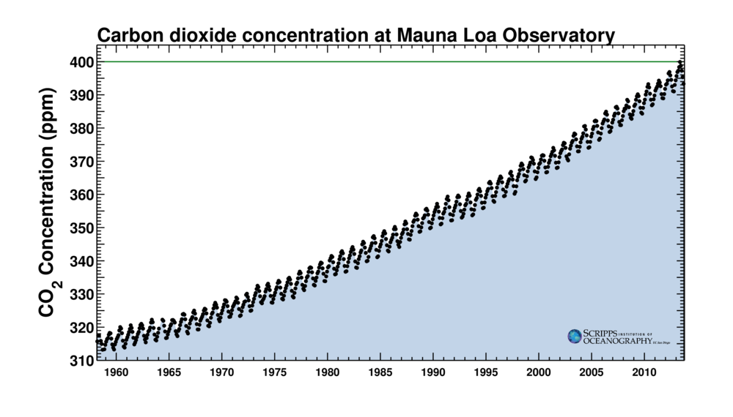
The Rise of CO₂
400 ppm = 400 parts-per-million = 0.04% by volume
2 ppm/yr
reference
Charles Keeling (SIO/UCSD), started measuring atmospheric CO₂ from Mauna Loa in
Hawaii in 1958. Besides the annual photosynthetic cycle, a profound trend is seen.

Slide 9
Is this Rise Surprising?
Every gram of fossil fuel used produces 3 grams of CO₂
it’s straight chemistry: to get the energy out via combustion, the carbon from the hydrocarbon gets attached to oxygen and off it goes
How much should we expect?
global energy budget is 4×10²⁰ J/yr from fossil fuels (5×10²⁰ J/yr total)
average 10 kcal/gram → ~40,000 J/gram → 10¹⁶ g/yr F.F.
so 3×10¹⁶ g/yr CO₂ → 3×10¹³ kg/yr CO₂
atmosphere has mass = 5×10¹⁸ kg → CO₂ adds 6 ppm/yr by mass
about 4 ppm/yr by volume (CO₂ is 44 g/mol vs. 29 for air)
50/50 to ocean/atmosphere, atmospheric rise is 2 ppm/yr, by volume
this is darned close to what we see on the “Keeling curve” graph

Slide 10
Total CO₂ Rise
We can do the same thing for the entire fossil fuel history
have gone through 1.2 trillion barrels of oil → 170 Gtoe
Gtoe is gigaton (10⁹ ton) oil equivalent (by energy)
used about 180 Gtoe coal worldwide
using 45 Gtoe U.S. times four, since U.S. uses ~25% of world energy
used 1100 tcf natural gas in U.S. → 30 Gtoe, so guess 120 Gtoe worldwide
470 Gtoe of fossil fuels → 1.4×10¹⁵ kg of CO₂ (3× FF mass)
280 ppm of atmosphere by mass; 180 ppm by volume
half into atmosphere → 90 ppm increase
see 115 ppm increase (280 ppm pre-industrial to 395 ppm today)
So the CO₂ increase is absolutely expected!

Slide 11
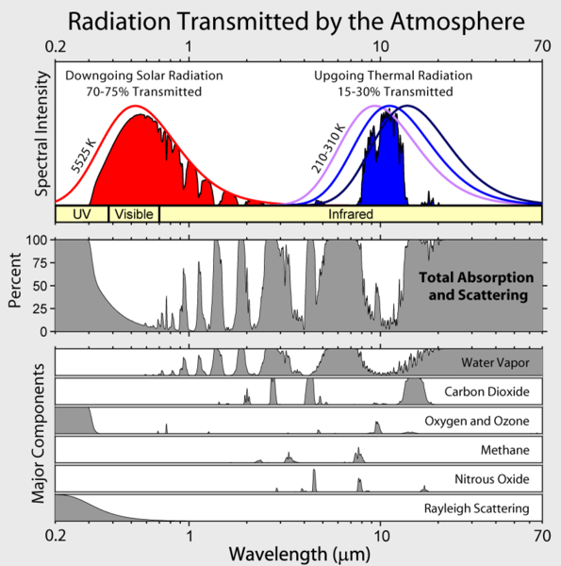
Expected Temperature Rise
Applying σT⁴ in radiative equilibrium, Earth is 255 K
but actual number is 288 K, thanks to 33 K greenhouse effect
If you add to the blanket, expect to get warmer
How much warmer?
we know that 7°C of the 33°C greenhouse effect is from CO₂
have gone from 280 to 385 ppm (11/8 times as much, or 3/8 increase)
“dumb” proportionality translates into 7°×3/8 = 21/8 = 2.6°C change
but takes some time because oceans are slow to respond, having enormous heat capacity
actual logarithmic nature approximately linear for small changes
Should be NO SURPRISE that burning loads of fossil fuels makes us warmer
not actually hard to understand!

Slide 12
Our Trajectory Today
Fermi Problems
Climate Change
Limits to Growth
Fossil Fuel Replacements?
Energy Storage
Fuel Economy of Cars and EV Math

Slide 13
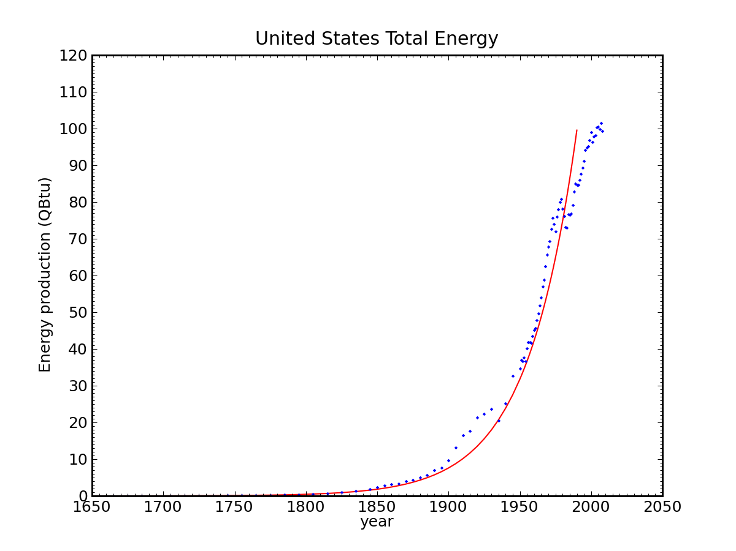
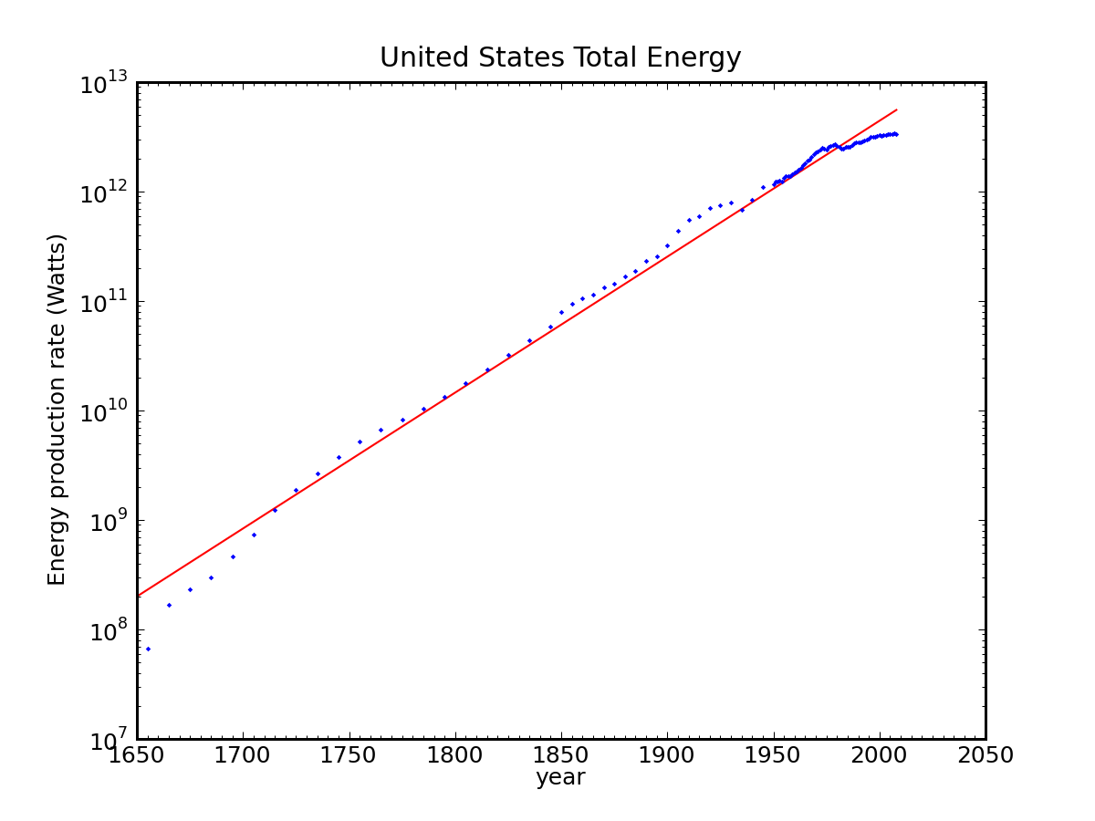
Exponential Estimations
logarithmic plot of the same
1650
2050
1650
2050
Sum of all forms of energy used in the U.S. (fossil fuels, nuclear, hydro, wood, etc.)
Red curve is exponential at 2.9% per year growth rate
World is at 16 TW now; pick 2.3% rate, mapping to 10× per 100 yrs.

Slide 14
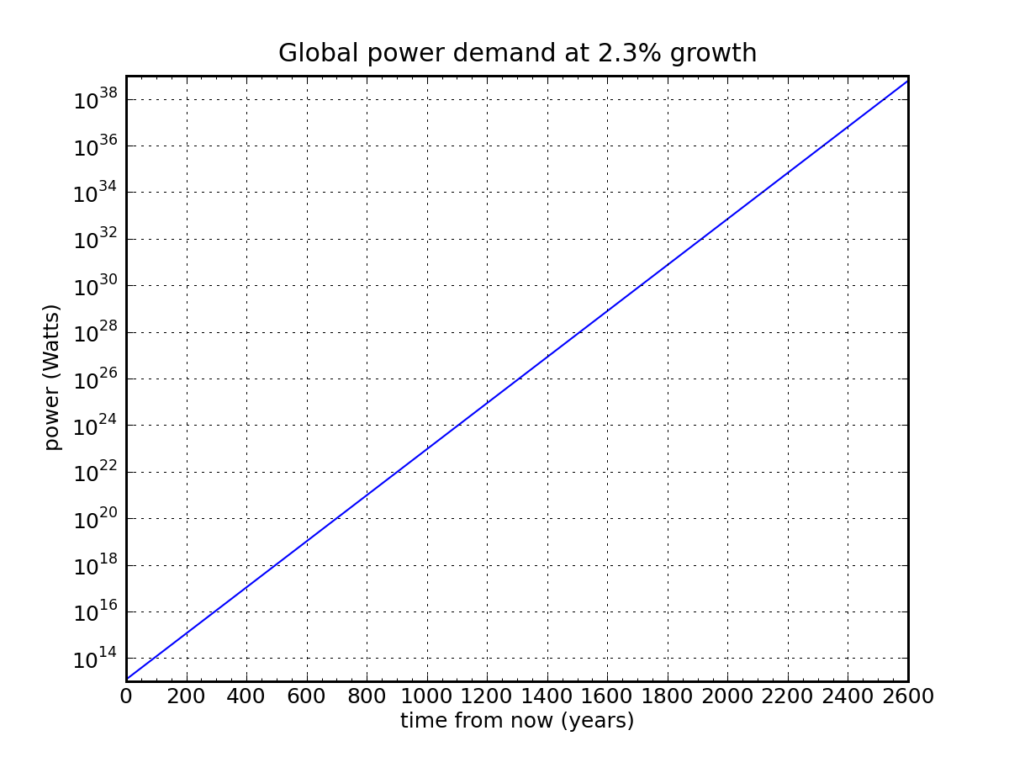
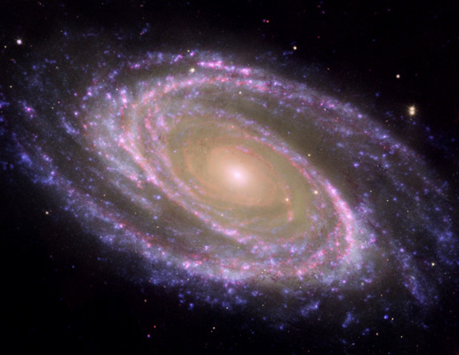
Extrapolating at 10× per Century
power output of the entire Milky Way galaxy
power output of sun
~2500 years
1340 years
solar power reaching Earth’s upper atmosphere
all solar
solar power reaching Earth’s land
land
405 yr
320 yr
16 TW today
(1.6×10¹³)

Slide 15
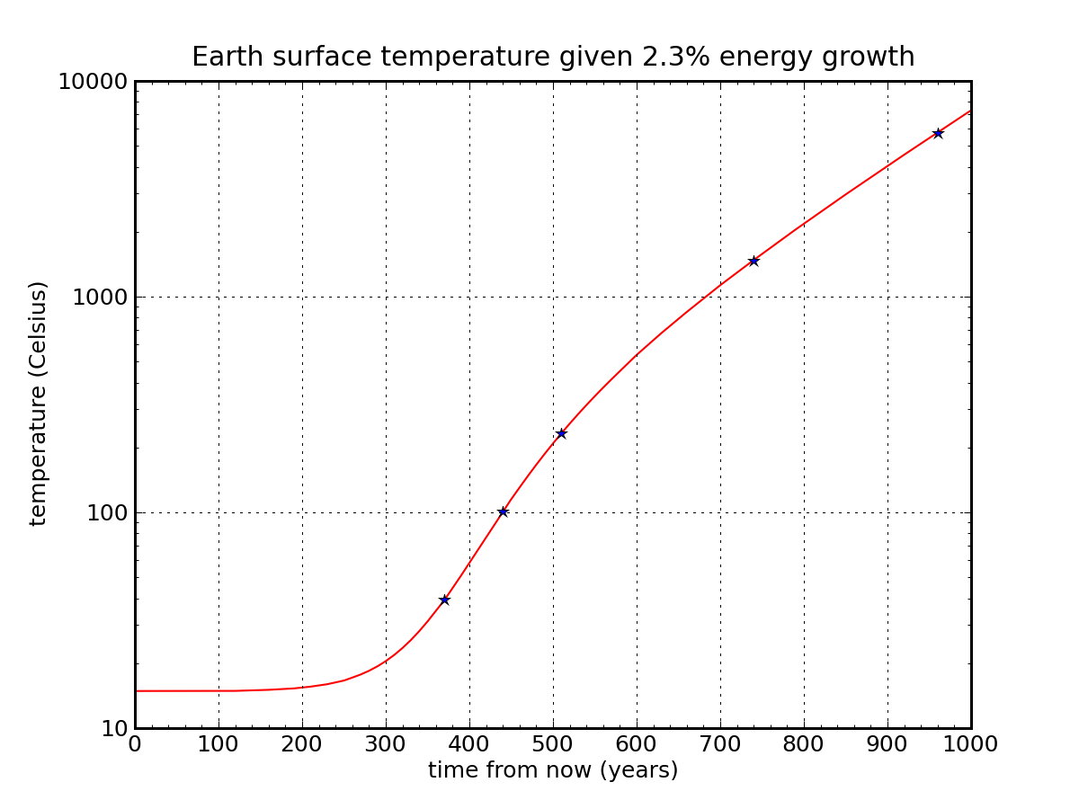
Waste Heat Boils Planet (not Global Warming)
sun surface temperature
thermodynamic consequence of
arbitrary energy technology on Earth
steel melts
paper burns
water boils
body temperature
global warming?
Straightforward application of σT⁴ radiative disposal of heat: only ticket off planet

Slide 16
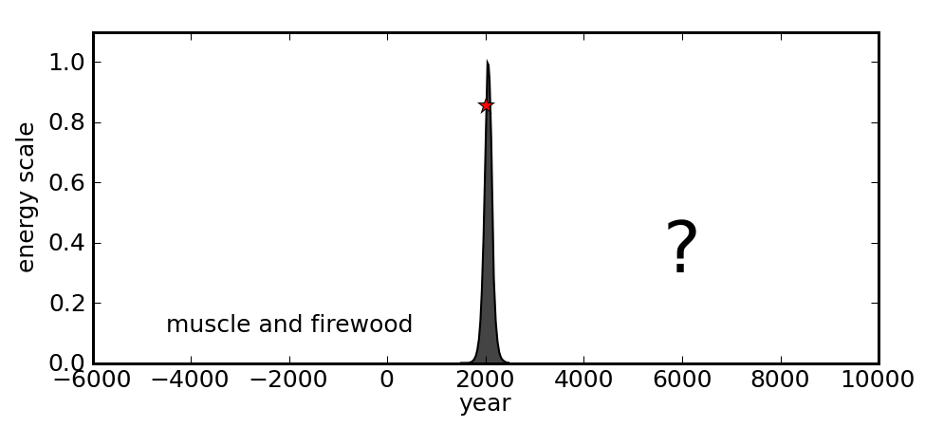
Physics Predicts an End to Economic Growth
Physical growth (energy, population, etc.) on finite Earth is clearly limited
Physical resources will always be an important component of economic activity (never below 10%, for instance?)
Cap in physical growth means cap in economic growth
Growth is a transitory phase, so major adjustments ahead
Fossil Fuel trajectory is set: growth during ascent; what next??
we are here

Slide 17
Our Trajectory Today
Fermi Problems
Climate Change
Limits to Growth
Fossil Fuel Replacements?
Energy Storage
Fuel Economy of Cars and EV Math

Slide 18
Estimating Post-Fossil-Fuel Resources
Usually not that hard to put numbers/limits on resources
precision is not the goal: sort out major and minor players
Some cute ideas quickly dispensed with numbers
lots of distractions out there
Example: Wave Power
1 meter high, 2 m thick, 1000 kg/m³ → 2000 kg per meter along wave
raised average of 0.5 m → mgh = (2000×10×0.5) = 10,000 J per meter
double to capture kinetic energy contribution → 20,000 J
wave every 10 seconds → 2,000 W for each meter of coastline
coastlines ring world twice (two major sets of continents)
so about 100,000 km of (projected) coastline
10⁸ m of coastline times 2×10³ W per meter → 2×10¹¹ W, or 0.2 TW
about 1% of global demand if fully developed!

Slide 19
Categorize into Long-term Abundance/Scale
Clearly Abundant:
Solar of various flavors (including algal biofuels?)
Breeder-type nuclear (uranium or thorium)
One-time geothermal (unsustainable mining of heat resource)
Ocean thermal energy
Fusion
Intermediate (potential real player):
Wind; Geothermal for heating; Cellulosic Biofuels; Ocean Current
Borderline (small, but relevant player):
Hydroelectric
Niche (small beans; special locations):
Geothermal Electricity; Tidal; Conventional Fission; Biofuels from food crops; Ocean waves

Slide 20
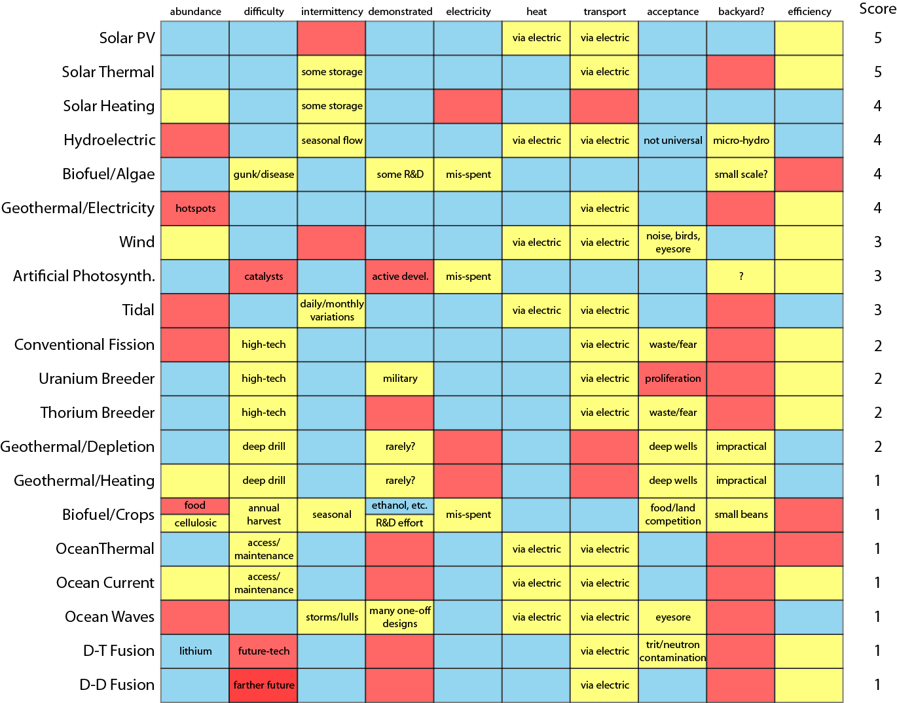
Matrix of Considerations; Crude Scores
Host of practical considerations
blue: good (+1)
yellow: marginal/okay (0)
red: insufficient (−1)
Created for Do the Math blog
Each topic has dedicated blog page
Note that fossil fuels beat the pants off of alternatives
Spells rough adjustment ahead
Lots of electricity sources
Few transportation options
mind the gap!
Do the Math: The Alternative Energy Matrix

Slide 21
Corn Ethanol or Bust
Let’s calculate how much land we need to replace oil
an Iowa cornfield is 1.5% efficient at turning incident sunlight into stored chemical energy
the conversion to ethanol is at best 30% efficient
assuming 1.4:1 energy-return:energy-invested, and using corn ethanol to power farm equipment and ethanol production itself
growing season is only part of year (say 50%)
net is 0.23% efficient (1.5% × 30% × 50%)
need 40% of 10²⁰ J per year = 4×10¹⁹ J/yr to replace petroleum
this is 1.3×10¹² W: thus need 6×10¹⁴ W input (at 0.23%)
350 W/m² summer insolation, need 2×10¹² m², or (1,400 km)² of land
that’s a square 1,400 km on a side; as a lower limit

Slide 22
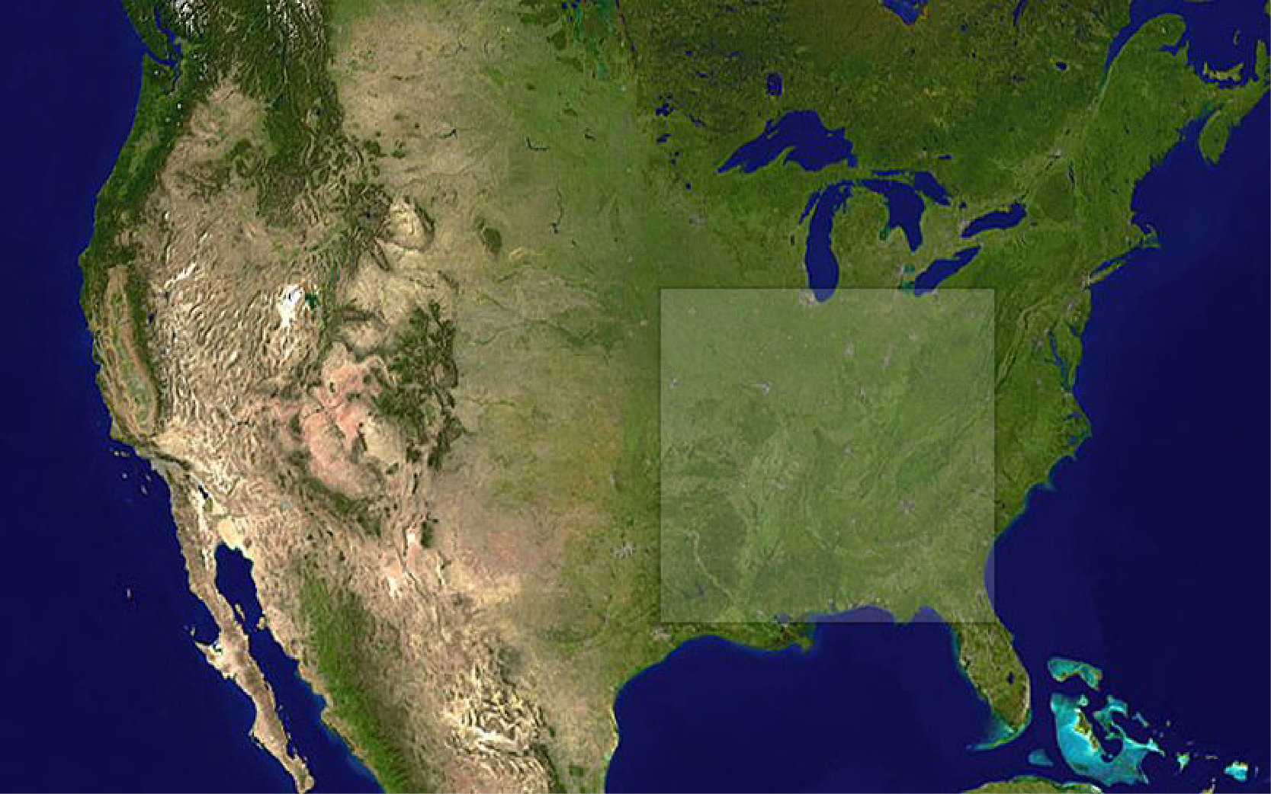
What Does this Amount of Land Look Like?
We don’t have this much arable land!
And where do we grow our food?

Slide 23
Our Trajectory Today
Fermi Problems
Climate Change
Limits to Growth
Fossil Fuel Replacements?
Energy Storage
Fuel Economy of Cars and EV Math

Slide 24
Energy Storage
A major transition away from fossil fuels to solar, wind, etc. will require massive storage solutions
The cheapest go-to solution for stand-alone systems has been lead-acid batteries
but national battery would be a cubic mile, and require more lead than is estimated to exist in global resources (let alone proven reserves)
We can use estimation techniques to evaluate possible solutions
focus on home-scale solutions
scale will be 100 kWh of storage (3 days elec. for average U.S. house)
explore gravitational, batteries, compressed air, flywheels

Slide 25
Gravitational Storage
Hoisting rocks or pumping tanks of water: low tech approach
A rechargeable AA battery (1.5 V, 2 A-h → 3 Wh ≈ 10 kJ)
Hoisting mass on 3 m derrick: need 300 kg to match AA battery
gravitational storage is incredibly weak
100 kWh, in menacing 10 m high water tower, needs 3600 m³
15 meters on a side
oops
legal hurdles; frightened neighbors

Slide 26
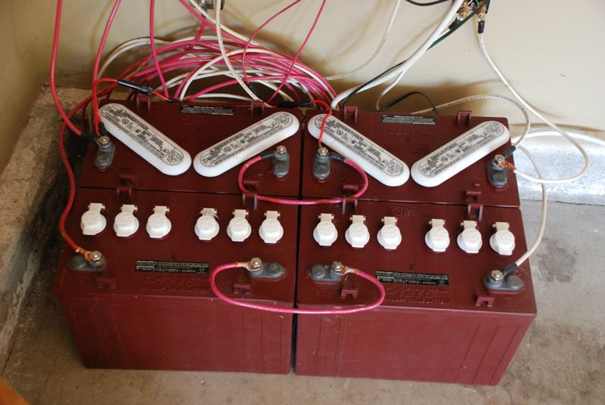
Lead-Acid Batteries
Each reaction involves a Pb atom in the anode, a PbO₂ molecule in the cathode, and two electrons at 2 eV each
100 kWh (3.6×10⁸ J) needs 10²⁷ Pb atoms
1700 moles; 355 kg of lead; might guess 4× realistic
real batteries would have 1500 kg of lead (2500 kg total battery mass)
2500 kg at 2.5× density of water → 1 cubic meter
will cost $15,000, and last 3−5 years
actually, the cheapest, most compact of the four non-fossil storage means we’re considering
For U.S. to go full solar/wind requires significant storage
not enough lead in world resources (let alone reserves) to build for U.S.

Slide 27
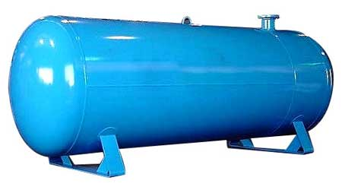
Compressed Air
Charged to 200 atm, energy is P₀V₀ln(P_{f}/P₀) = 5.3P₀V₀
simple integration of PdV = NkT(dV/V)
P₀ = 10⁵ Pa
Need 5.3×10⁵V₀ = 100 kWh = 3.6×10⁸ J
V₀ = 700 m³
V_{f} = 3.5 m³
cube 1.5 meters on a side

Slide 28
Flywheel
Solid cylinder: I = ½MR²
Edge velocity, v → ω = v/R; E = ½Iω² = ¼Mv²
Pick edge velocity v = 300 m/s
Need 16 ton mass
At density of steel, this is 2 cubic meters
e.g., 2 meters high; 1.2 meter diameter
acceleration at edge; v²/R is 16,000g
break-up: exceeds mechanical strength
need larger, slower to be safe: 2.5 m diameter, 125 m/s
10 m³; 80 tons → 1250g
can get 25 kWh
unit 2×3 m; $100k

Slide 29
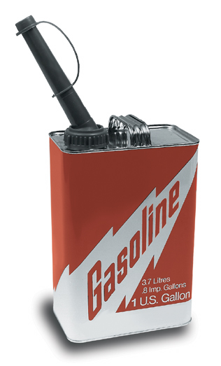
Heck: Just Use a Generator!
Each gallon of gasoline contains 36.6 kWh of thermal energy
Home Depot generator probably 15% efficient
seems like the rest comes out in noise!
about 5 kWh of electricity per gallon
For 100 kWh, need 20 gallons (75 liters) of gasoline
gasoline: 0.075 m³
lead acid: 1.0 m³
compressed air: 3.5 m³
flywheel: 10 m³
water/grav at 10 m: 3600 m³
Hard to beat fossil fuels!
by far the cheapest, too

Slide 30
Our Trajectory Today
Fermi Problems
Climate Change
Limits to Growth
Fossil Fuel Replacements?
Energy Storage
Fuel Economy of Cars and EV Math

Slide 31
Is 100 MPG from Gasoline Possible?
At freeway speeds, mainly fight drag: F_{d} = ½ρc_{D}Av²
ρ = 1.2 kg/m³, c_{D} ≈ 0.3, A ≈ 2.5 m², v = 30 m/s
F_{d} ≈ 400 N
Rolling resistance is about 0.01mg ≈ 100 N (indep. of v)
Net 500 N
A gallon of gasoline (3 kg × 10 kcal/g × 4.18 kJ/kcal) contains about 130 MJ of energy
Used at ~25% efficiency in internal combustion engine
W = F×d → d = 30 MJ / 500 N = 60 km ≈ 35 miles
100 MPG from gasoline at freeway speeds is super-hard
need a factor of four improvement in drag piece, for instance
even a trout-shaped car unlikely to achieve this

Slide 32
Electric Vehicle (EV) Math
Any window sticker will confirm: 30−35 kWh of juice from the wall socket provides 100 miles of travel
using 33.5 kWh/gallon (lower heating value) → ~100 MPG equiv.
but if from 35% efficient fossil fuel plant, back to 35 MPG
Li-ion batteries in EVs store 0.08−0.13 kWh/kg
so 300 mile range would require 100 kWh ,or 1000 kg of battery
Today’s EV battery cost is $500/kWh
300 mile range costs $50,000 in battery alone (hellooo, Tesla!)
reach gasoline cost after 500,000 miles of driving (at $4/gal, 40 MPG)
battery will not last that long: need ~4× reduction in battery price for cost parity
not to say price should dictate everything: other reasons to adopt EV

Slide 33
Charging Bottleneck
Adding gasoline to tank at 6 gallons per minute:
3.6 kWh/sec = 13 MW of power!
two cars filling at a gas station = UCSD campus power demand!
Charge efficiency 70−80%
other 20−30% generates heat
Try sticking 100 kWh into a battery in 10 minutes
600 kW of power (current EVs typically accept 100−200× less)
100 houses with A/C blasting; almost 1000 horsepower
120 kW in heat/loss
distributed over 6 m² (cube 1 m on a side), 20 kW/m²
naïvely hundreds of degrees Celsius temperature rise
unless aggressively water-cooled: not an easy job

Slide 34
Summary
We often know more than we think about a problem
Real world problems don’t come with tidy numbers attached
Estimation and multiple techniques often fruitful
have to at least try to solve a problem: dig in
Straightforward exercise to expose major future challenges
basic assumptions about growth and energy are typically wrong
Every congressperson should have an estimator on their staff
and then actually LISTEN to them!

